Slide 1
DSC 106
Final Project
Beeg Data
Arjun Sawhney & Tanveer Mittal

Slide 2
Introduction
Historic NYPD misconduct complaint data: https://catalog.data.gov/dataset/nypd-complaint-data-historic
Rich in demographic and geographic information
Approximately 7 million records from 2006-2019

Slide 3
Motivation
Policing is an important & highly relevant topic in society
Large scale protests
Highly debated legislation
Eric Garner chokehold ban passed under NYPD reform after 7 years
Investigate the phenomenon of crime in New York through visualization

Slide 4
Data Pipeline
Filtering & Selection
Filter for complaints generated after the year 2006
For the bar chart, we filtered out categories with <6000 counts to reduce clutter
Relevant attributes selected: see next slide
Pre-processing
Extract year and month as strings from report-filed-date column
For sankey diagram, we grouped by suspect/victim races and constructed a graph with weighted edges
Each node is a race value and the edges represent relationships between suspect/victim race

Slide 5
Plots + Encodings
Line plot
Goal
Historical trends of # of complaints by crime category
Attributes
Every month from 2006-2019
Number of complaints
Crime category (checkbox selection)
Bar Chart
Goal
Quantitative distribution of complaint categories
Attributes
Complaint category
Number of complaints
3) Proportional Symbol Map of NY state complaints
Goal
Temporal analysis of complaints by precinct
Attributes
Coordinate Location
Precinct
Number of complaints
Year (slider selection)
Crime category (checkbox selection)
4) Sankey Diagram
Goal
Identify victim and officer race relationships in complaints
Attributes
Race of victim and officer
Number of complaints

Slide 6
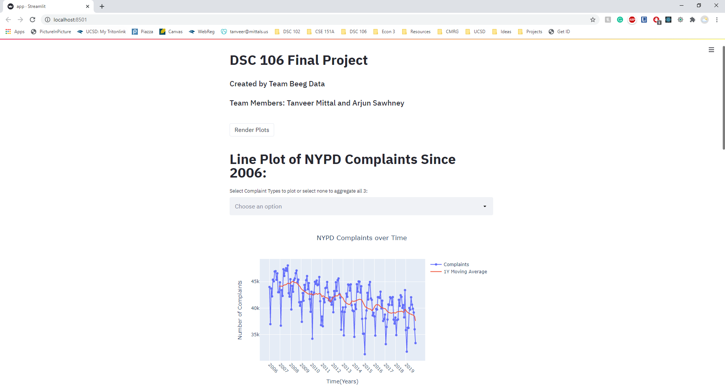
Interactive Visualization Dashboard
Install and run instructions: https://github.com/TanveerMittal/DSC_106_Final_Project

Slide 7
Methods & Design Principles
Dependencies
numpy, pandas, plotly, folium, streamlit, streamlit_folium
Interaction
Hover, zoom, and focus in all plots
Checkbox selection for line plot and map visualization
Popup labels on hover / click of points on map
Slider for year selection for map visualization
Pre-attentive Processing & Gestalt Principles
Colour perception:
Charts are not overloaded with too many colours
Only one colour in bar chart due to too many categories
Legend labels coloured with same colour as lines
Visual perception:
Bar chart sorted in descending order
Map point radius scales in proportion to number of complaints
Proximity clusters seen on map visualization
Large titles to determine reading hierarchy
Reduced clutter:
No chart-junk
Clearly labelled axes
Grid lines in the background

Slide 8
Visualization Insights
Plot 1
Observe seasonality of complaints: Peak in the summer, dip in the winter.
Overall downward trend of # of complaints. Violations remain roughly static over time
Possible correlation with seasonality and trend of crimes
Plot 2
Petit larceny, assault, and grand larceny crimes generate the most complaints
Fraud, arson, and administrative code violations generate the least complaints
Plot 3
Redistribution of complaint / crime hotspots and clusters in NY state by crime category over time
Most complaints are filed for misdemeanors, followed by felonies, then violations.
Complaint clusters in lower income precincts containing majority black and hispanic victims.
Plot 4
Complaints filed by victims are largely against suspects from the same race
Minorities generate the most complaints: Black and Hispanic victims dominate complaint records.

Slide 9
Determination
Cannot conclusively determine whether reform is warranted through visualization. Random control experiments and thorough analysis required to make this determination
It is noteworthy that minority victims generate the most complaints for misconduct against NYPD police officers.
Proportional Symbol Map of NY state complaints shows clusters in lower income precincts containing majority black and hispanic victims.

Slide 10
Challenges
Large dataset with manually entered records comes with implicit challenges of high missingness, data cleaning, and filtration steps
Large compute runtimes make interactive dashboard slow to load and update
Data dictionary required to interpret column attributes

Slide 11
Thank You!
Feel free to ask any questions!

